Slide 1
Project 2 Team
CS504 Team Project
Spring 2025

Slide 2




PROJECT 2 TEAM
Scrum Master:
Iris Duan
Product Owner: Brian Haggerty​
Developer:
An Huynh
Developer:
Roger Graham​

Slide 3
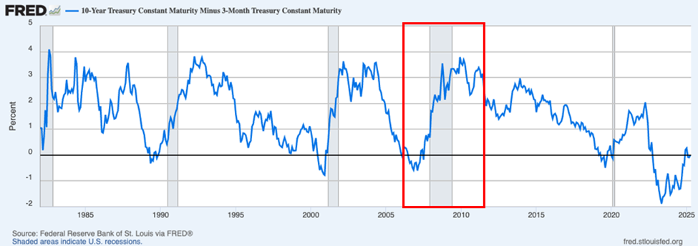
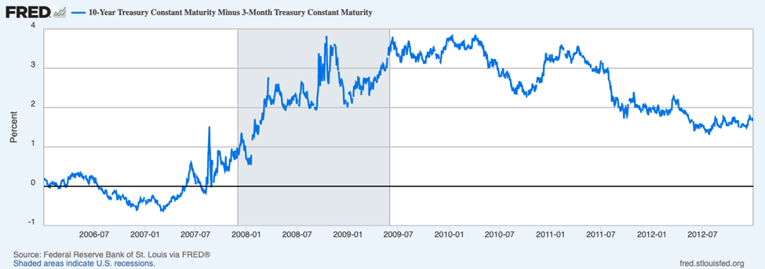
Problem Definition
Our analysis delivers value to policymakers and mortgage lenders by providing insights into the correlations between the yield curve and the housing market with the 2008 recession.
Yield Curve: Measures the spread between long term and short-term interest rates on government issued bonds.
(10 year and 3 months in this case).

Slide 4
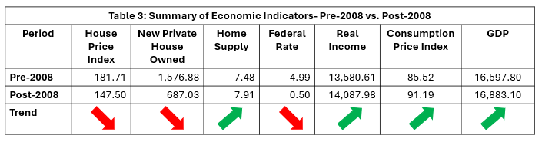
Data Processing and Quality
GDP: Gross Domestic Product

Slide 5

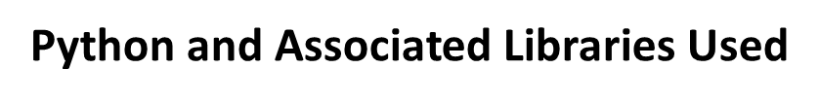





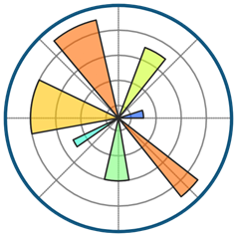

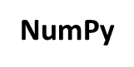
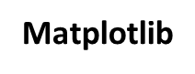


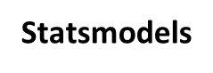

Analytic Methodology
GitHUB used for code version control and data storage

Slide 6
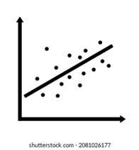


Models Explored During the Process – Two Steps
Step 1:
Logistic Stats Model was used for statistical hypothesis testing
OLS was used for variable strength testing
Step 2:
Machine Learning Models employed for binary classification task:
Random Forest Classification model
XGBoost Classification model
Notes:
Suggest we concentrate on Metadata and NLP and NOT Externals other than what results from associations between metadata and content

Slide 7
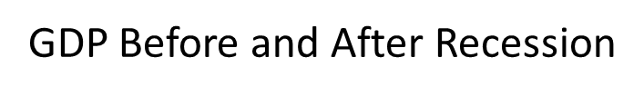
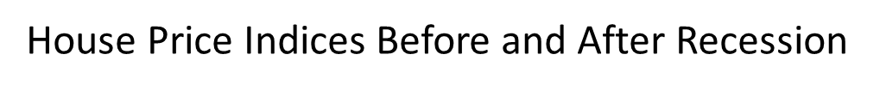
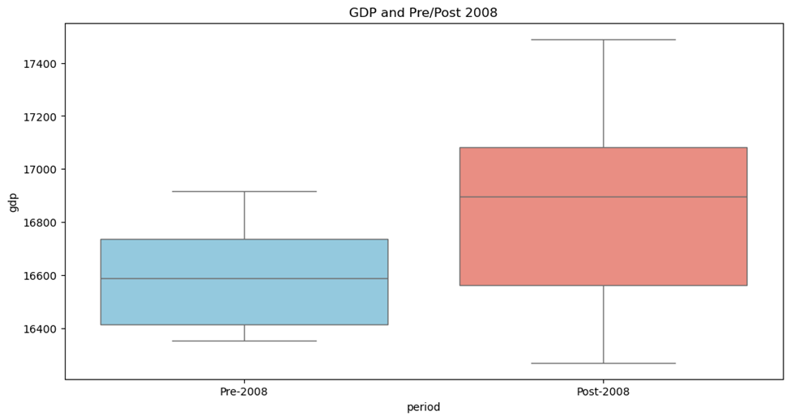
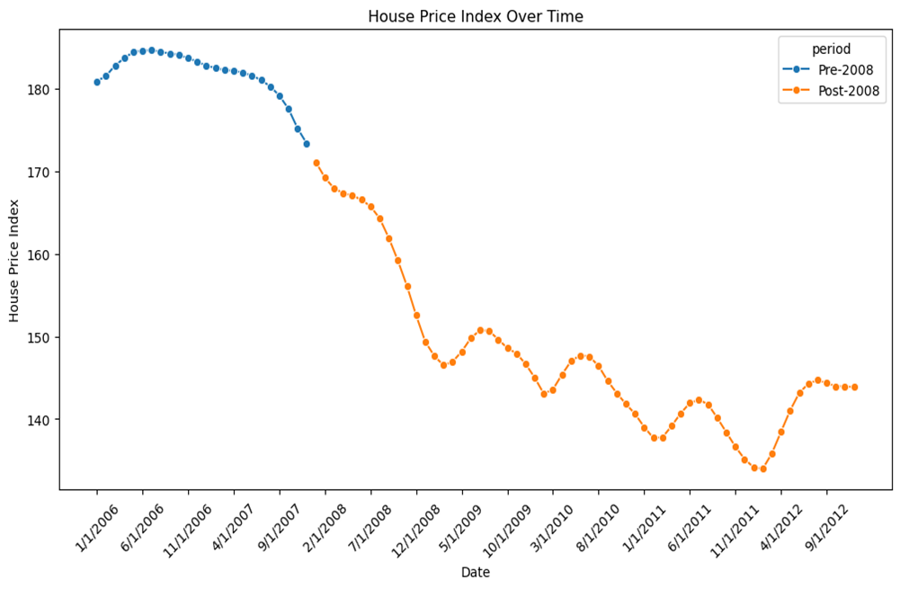
Visuals
GDP
House Price Index
Pre-2008 Post-2008
Period
Date

Slide 8
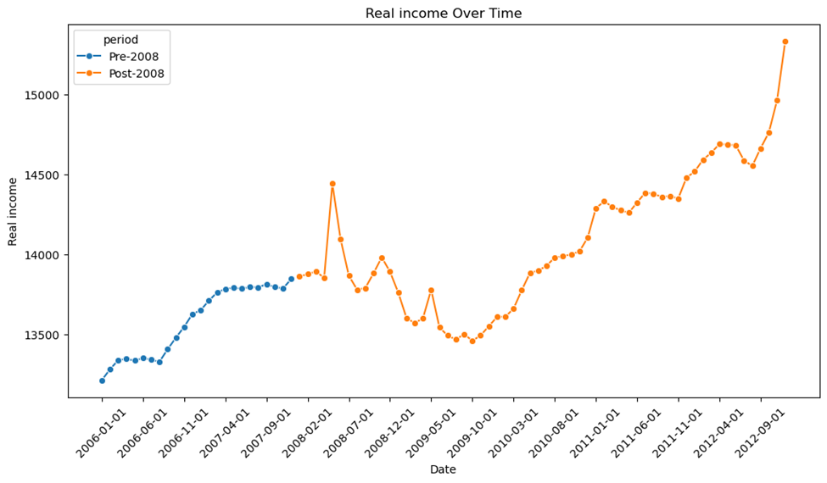
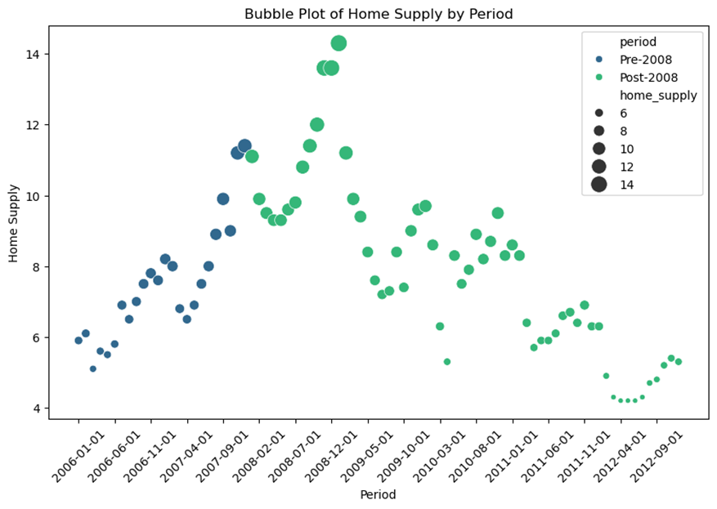
Visuals
Real Income over Time
Bubble Plot of Home Supply by Period
Real Income
Home Supply
Date
Date

Slide 9
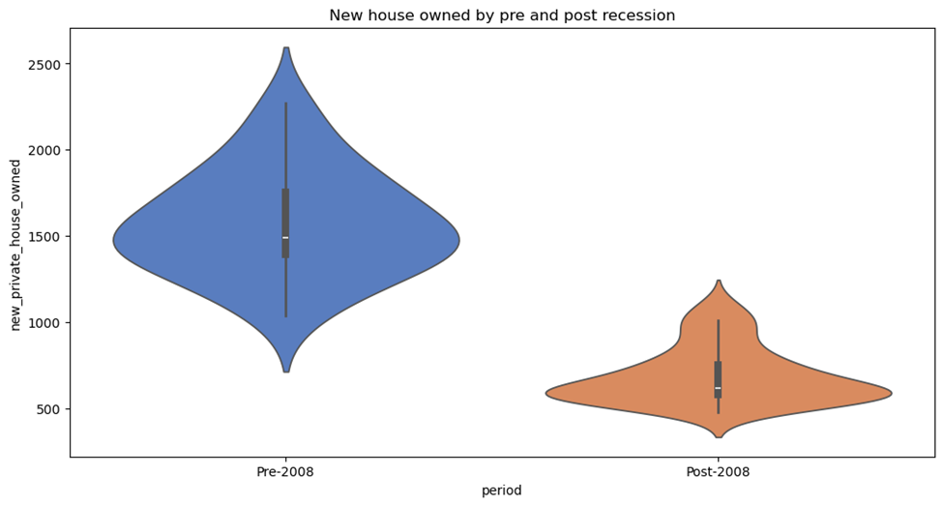
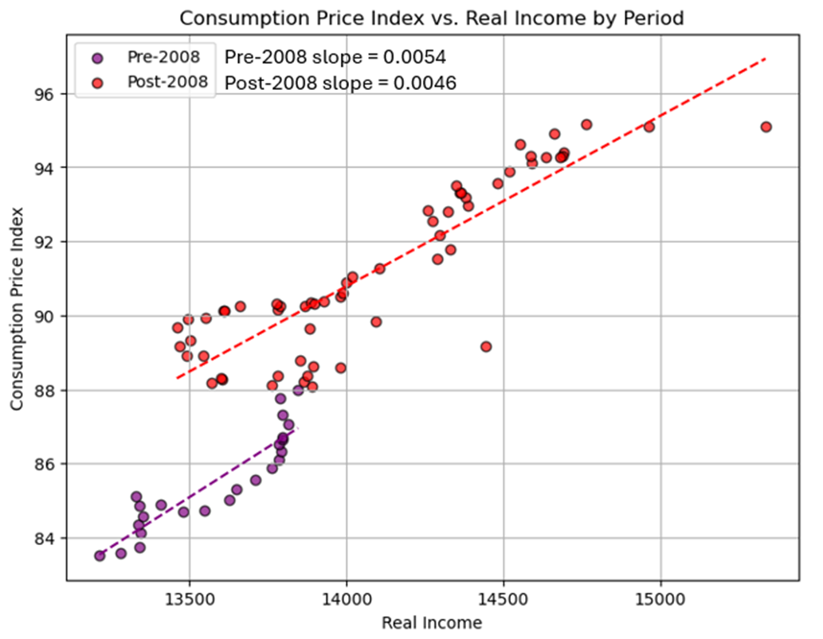
Visuals
New Private Houses Owned
Before and After 2008 Recession
Consumption Price Index vs. Real Income
Before and After 2008 Recession
New Private Houses Owned
Consumption Price Index
Pre-2008 Post-2008
Period
Real Income

Slide 10
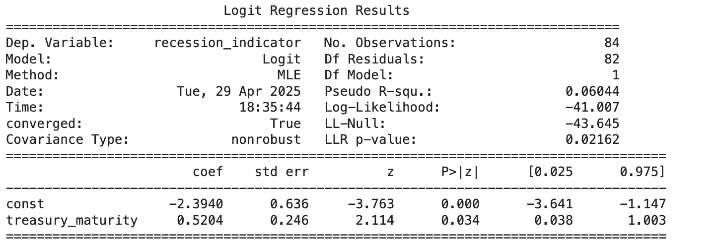
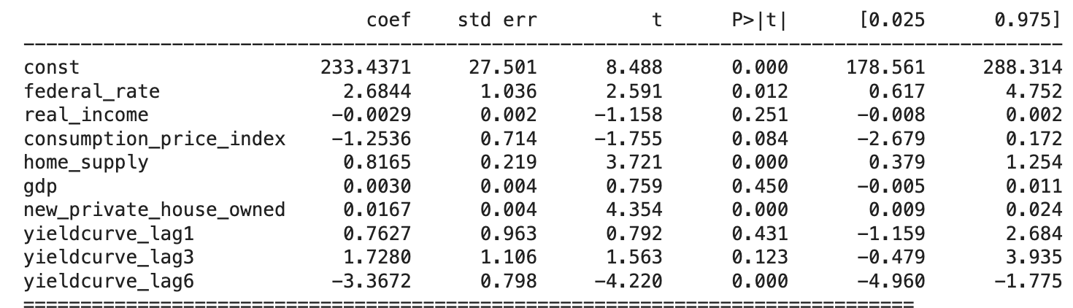
Findings – Statistical models 📊
The p-value is 0.02162, which is less than 0.05, meaning that there is a statistically significant relationship between yield curve and probability of recession
Based on the p-values, the indicators that are statistically significant are:
Federal Funds Rate
Home Supply
Newly Privately Owned Housing Units
Yield Curve (lagged by 6 months)

Slide 11
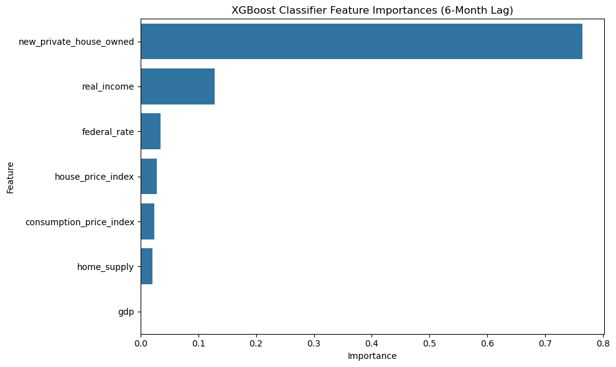
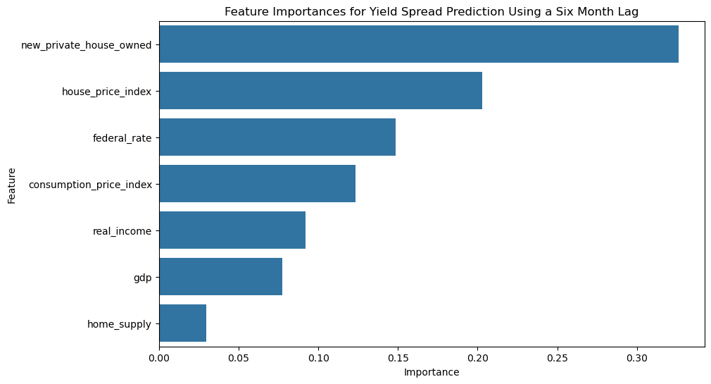
Findings – Machine learning models
The AUC score of 1.0 demonstrates that this model is a strong candidate for predicting treasury maturity based on key macroeconomic indicators.
Top 3 features importance: 🌈🌈🌈
Newly Privately Home Owned Units
Real Income
Federal Funds Rate
🌈🌈🌈
The AUC score, which is 1.0, indicates that the model can perfectly distinguish between high and low treasury maturity.
Top 3 features importance: 🌳🌳🌳
Newly Privately Home Owned Units
House Price Index
Federal Funds Rate
🌳🌳🌳

Slide 12
Summary – Model Selection Rationale
✅ Model performance
Both Random Forest Classifier and XGBoost Classifier achieved a perfect AUC-ROC score of 1.0, indicating excellent predictive capability.
However, perfect score on small datasets (85 datapoints) raise concerns of overfitting
⁉️ Why Random Forest model was chosen?
Criteria Feature Importance Sensitivity to Sample Size | Random Forest Align with OLS Results Less sensitive to small data | Reason High interpretability More robust than XGBoost

Slide 13
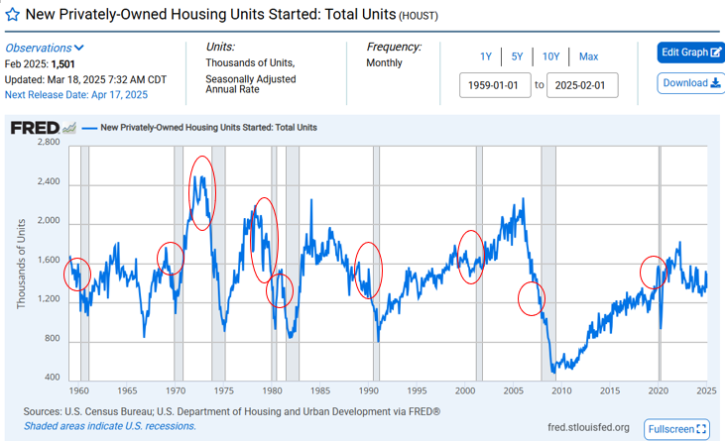
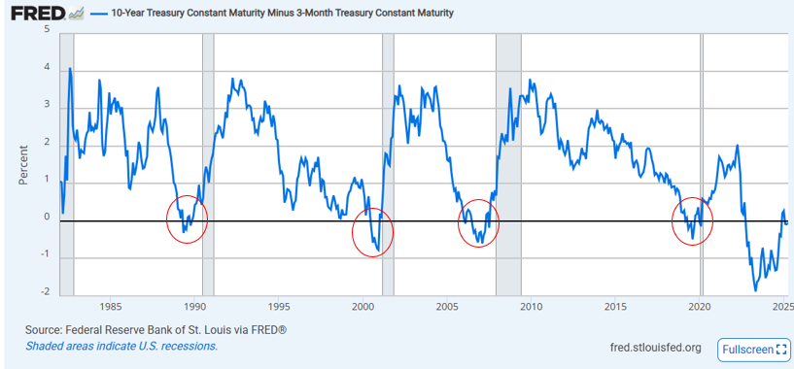
Next Steps
Explore:
Other recessions
Uniqueness of 2020 recession
(COVID 19 Pandemic)
Different Machine Learning Models
Other economic factors
Interest Rates
Consumer Confidence
Unemployment
Inflation

Slide 14
BACKUP SLIDES

Slide 15
Full Lexicon
BEA: Bureau of Economic Analysis
FEDFUNDS: Federal Funds Rate. This is the official rate set by the Fed and is used to control interest rates and inflation. It is the rate for overnight interbank lending. It acts as the basis for other interest rates. Tracked and published by the Fed.
FHFA: Federal Housing Finance Agency.
FRED: Federal Reserve Economic Data
GDPC1: Gross Domestic Product Consumption. Real GDP. The primary measure of economic health. It measures the total value of all goods and services produced in the US. The BEA tracks and reports this data. We are using real GDP in this case because it is the GDP adjusted for inflation and can thus give us a more accurate measure of economic health.
HOUST: Housing Starts. Shows the number of new residential projects that began in a monthly period. A decline in builder activity can indicate an economic slowdown. Data from the US Census and UHUD.
MSACSRNSA: Monthly Supply of Houses. Measures how many months it would take to sell all homes currently on the market at the current sales pace. Rising supply signals weakening demand and can signal price drops or recession. Data from FHFA.
PCEPI: Personal Consumption Expenditure Price Index. This is the Fed's preferred measure of inflation, and it is used to influence monetary policy.
UHUD: U.S. Housing and Urban Development
USRECQ: United States Recession Indicator. A binary indicator that shows whether the US was officially in a recession or not. The BEA provides this data.
USSTHPI: U.S. All-Transactions House Price Index. Tracks changes in U.S. residential property prices. Can help identify sharp price increases which indicate unstable growth that may precede a recession. Data comes from the FHFA.
Yield Curve: Measures the spread between long term and short-term interest rates on government issued bonds (10 year and 3 months in this case). It is derived from market forces and predictions. It has historically acted as a strong recession predictor.

